Slide 1
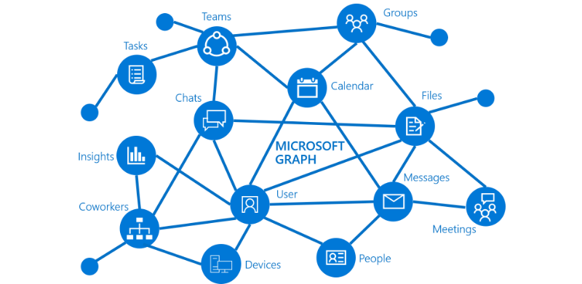
Microsoft Graph Lab

Slide 2

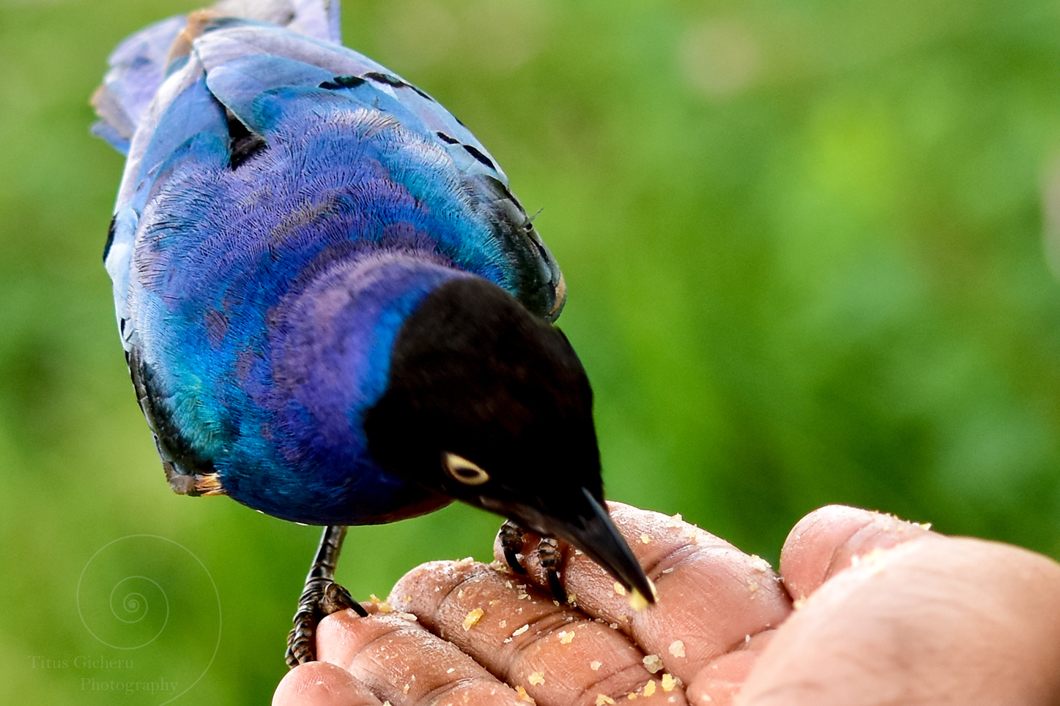


Titus Gicheru Software Engineer
@titusgicheru

Slide 3
Objectives
Using Microsoft Graph SDKs
Authentication using MSAL
Consume Graph using .NET SDK
Showcase a demo

Slide 4






Objectives

Slide 5
.NET Stack
ASP.NET
Console App
WPF
WinForms
UWP
Xamarin

Slide 6
Objectives
Install the Microsoft Graph SDKs
Microsoft.Client.Identity (MSAL)
Microsoft.Graph
Microsoft.Graph.Auth

Slide 7
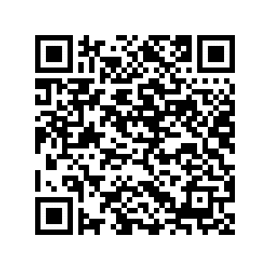
Choose an authentication provider
Automated Tests

Slide 8
Interactive flow
IPublicClientApplication clientApplication = InteractiveAuthenticationProvider
.CreateClientApplication(clientId);
InteractiveAuthenticationProvider authProvider = new
InteractiveAuthenticationProvider(clientApplication, scopes);
var graphClient = new GraphServiceClient(authProvider);

Slide 9


Graph Resources
Profile

Slide 10
User user = await graphClient.Me.Request().GetAsync();

Slide 11
IUserMessagesCollectionPage messages = await graphClient.Me.Messages
.Request() .Select("From, Subject, IsRead, IsDraft, HasAttachments, CreatedDateTime")
.GetAsync();

Slide 12

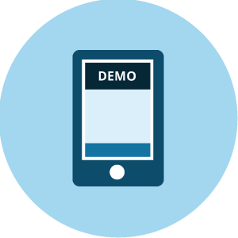
Overview
&
Automated Tests

Slide 13
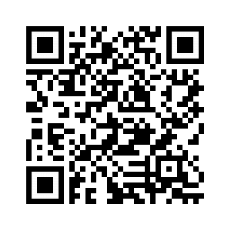
Overview
The repo
https://github.com/titusgicheru/winforms-sample-dotnet-sdk-csharp

